Slide 1
Processor Logic Design

Slide 2
Lesson-11:
Topic | Lesson Learning Outcomes | Teaching-Learning Methodology | Assessment Method
Processor organization | To understand the bus organization, memory organization, etc. To know the importance of scratchpad memory and accumulator register. Compare different processor organization | Class Lecture Question and answer | Test, exams, quiz, etc

Slide 3
Introduction
Terminologies
  Processer unit (Datapath)
    Processes digital data
  Control Unit
    Specifies the operation to be performed by processor
  CPU
    Combination of processor and control unit
  ALU
    A combinational circuit which is able to perform arithmetic and logical operations.

Slide 4
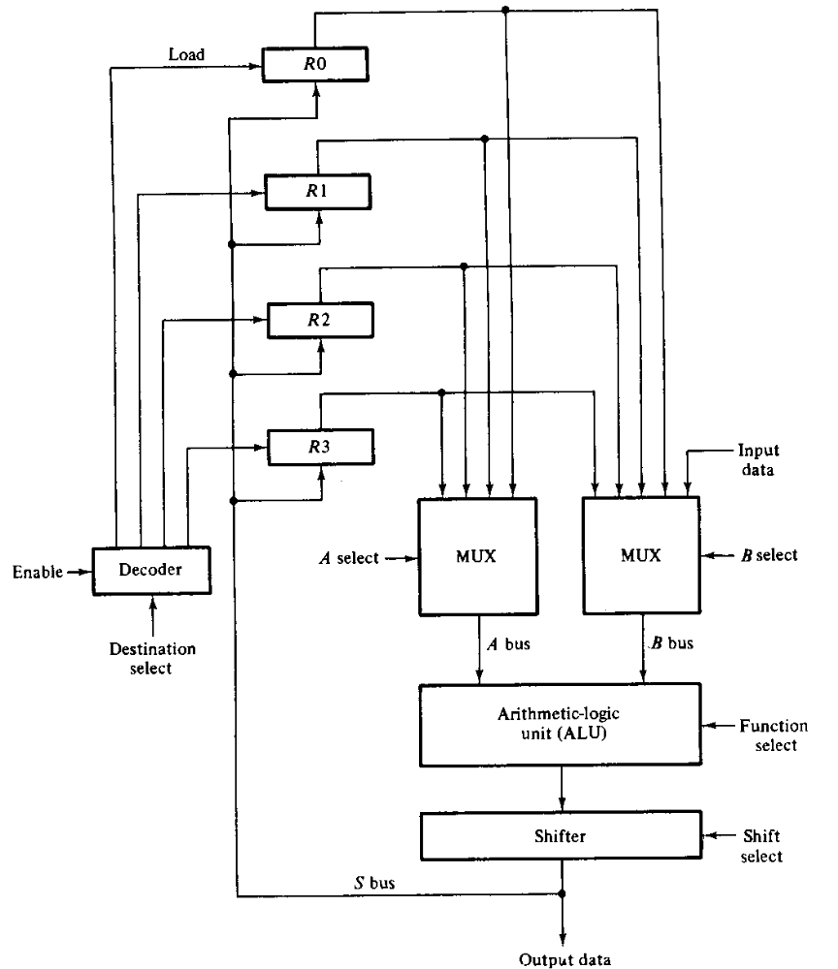
Processor Organization
Bus Organization
Perform
R1←R2+R3

Slide 5
Processor Organization
Scratchpad memory
  Alternative to many registers a single memory unit can be used
  Such memory unit is called scratchpad memory.
  It is different from the main memory.
  Figure shows a processor with scratchpad memory

Slide 6
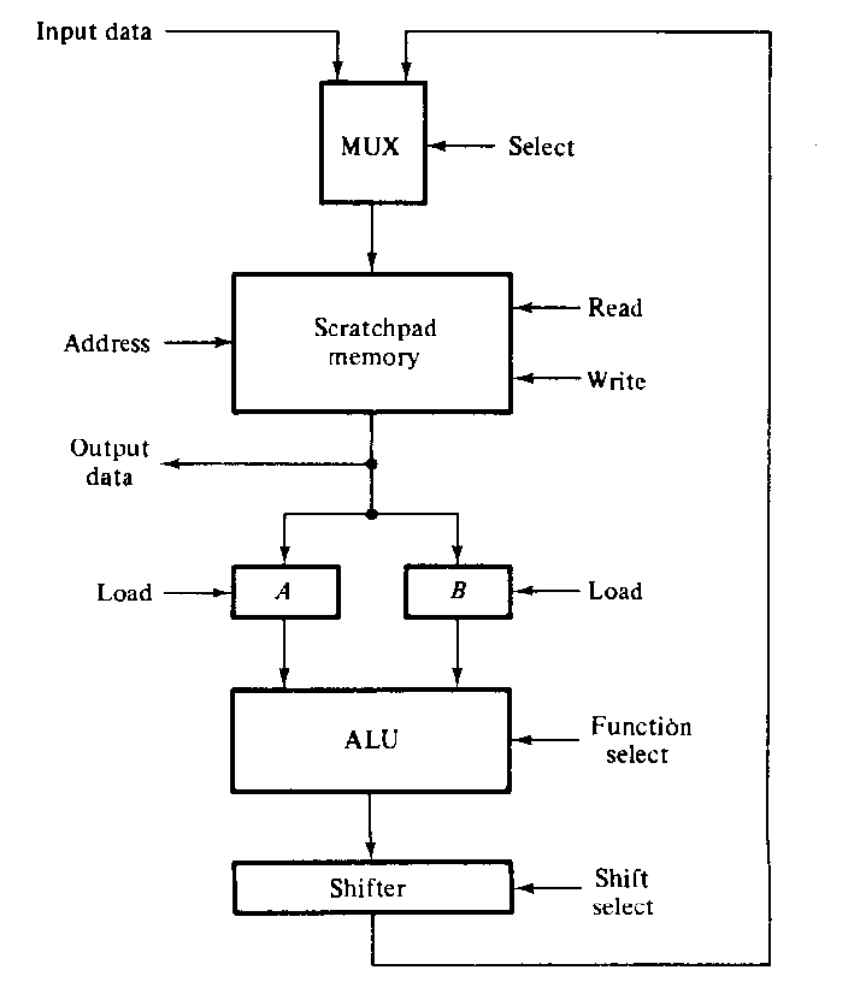
Processor Organization
Scratchpad memory
Perform
R1←R2+R3

Slide 7
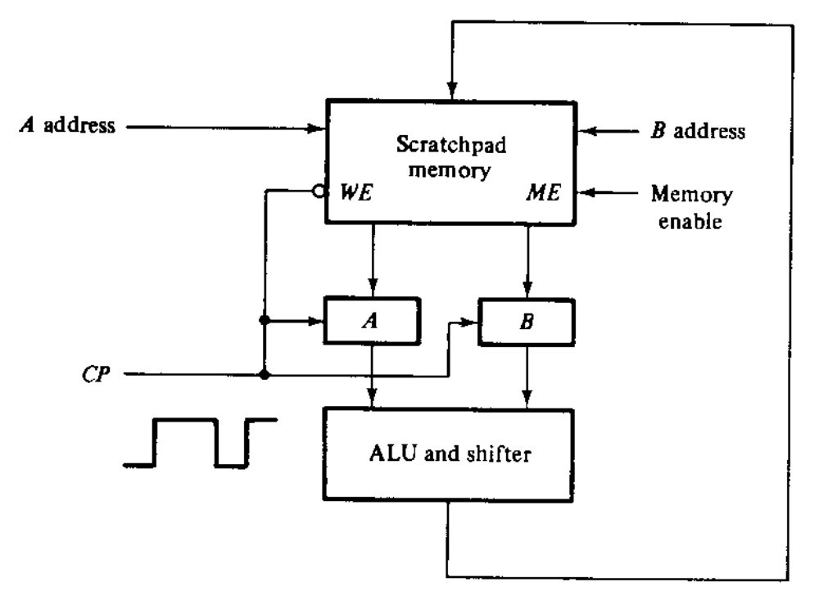
Processor Organization
Two-port Scratchpad memory
Perform
R1←R2+R3

Slide 8
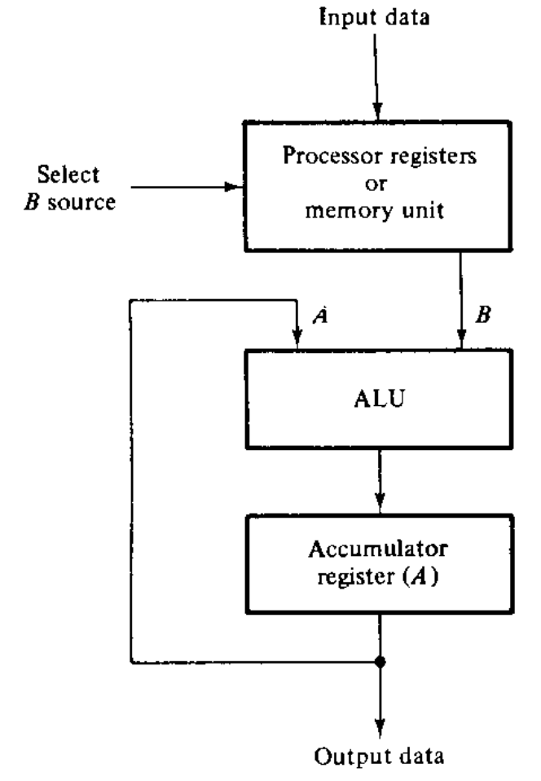
Processor Organization
Accumulator Register
  Different from other memory registers
  Used to perform serial addition
Perform
R1←R2+R3

Slide 9
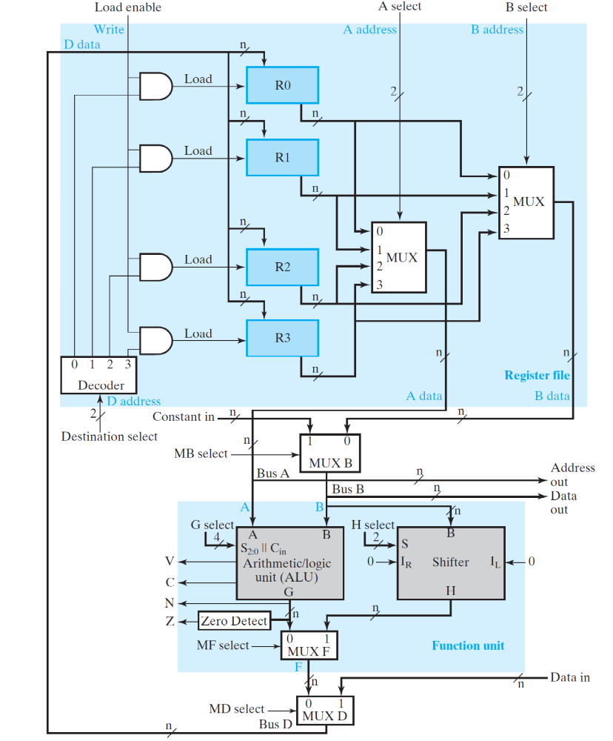
Processor Organization
Generic Datapath
Perform
R1←R2+R3

Slide 10
Lesson-12:
Topic | Lesson Learning Outcomes | Teaching-Learning Methodology | Assessment Method
Arithmetic unit | To understand the design principles of arithmetic unit To design arithmetic unit with a given set of arithmetic operations. | Class Lecture PBL (Solving some problems in class) | Test, exams, quiz, etc

Slide 11
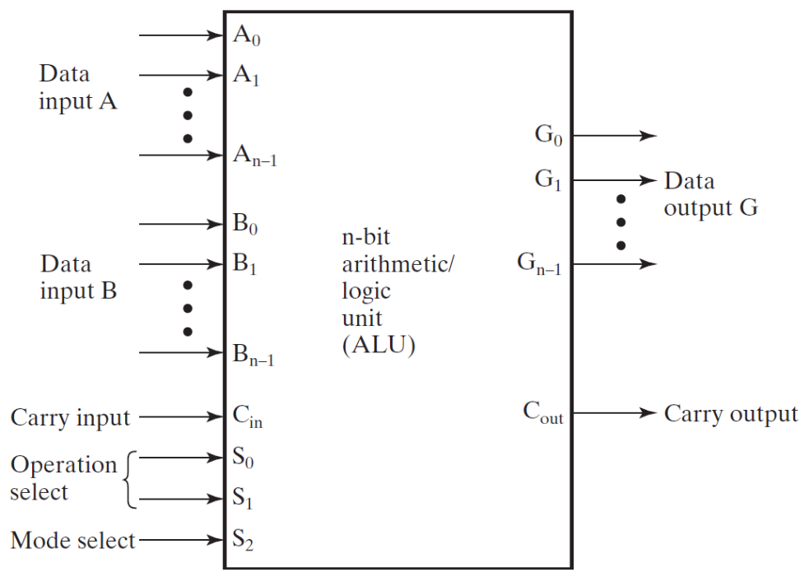
Arithmetic Logic Unit
The ALU
  Multi-operational Combinational Circuit.
  Fig. Shows a n-bit ALU
  Design Steeps
    Design of Arithmetic Unit.
    Design of Logic Unit
    Combine the above two.

Slide 12
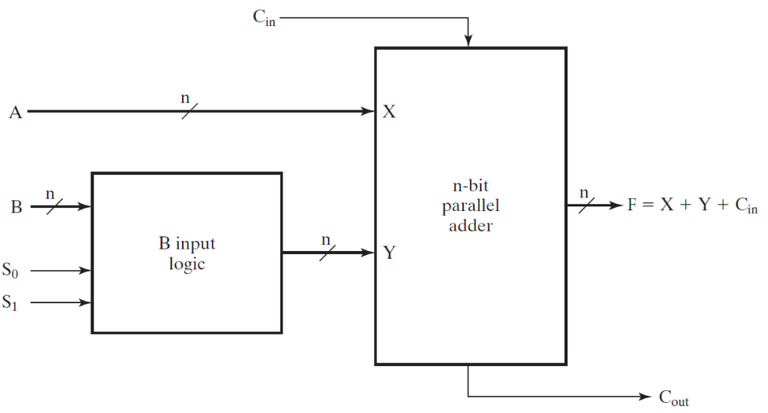
Arithmetic Logic Unit
Design of Arithmetic Unit
  Basic component is a parallel-adder.
  Fig. shows a n-bit arithmetic circuit
  Basic operations to be performed by the full-adder
    Addition
    Subtraction
    Increment
    Decrement
    Transfer

Slide 13
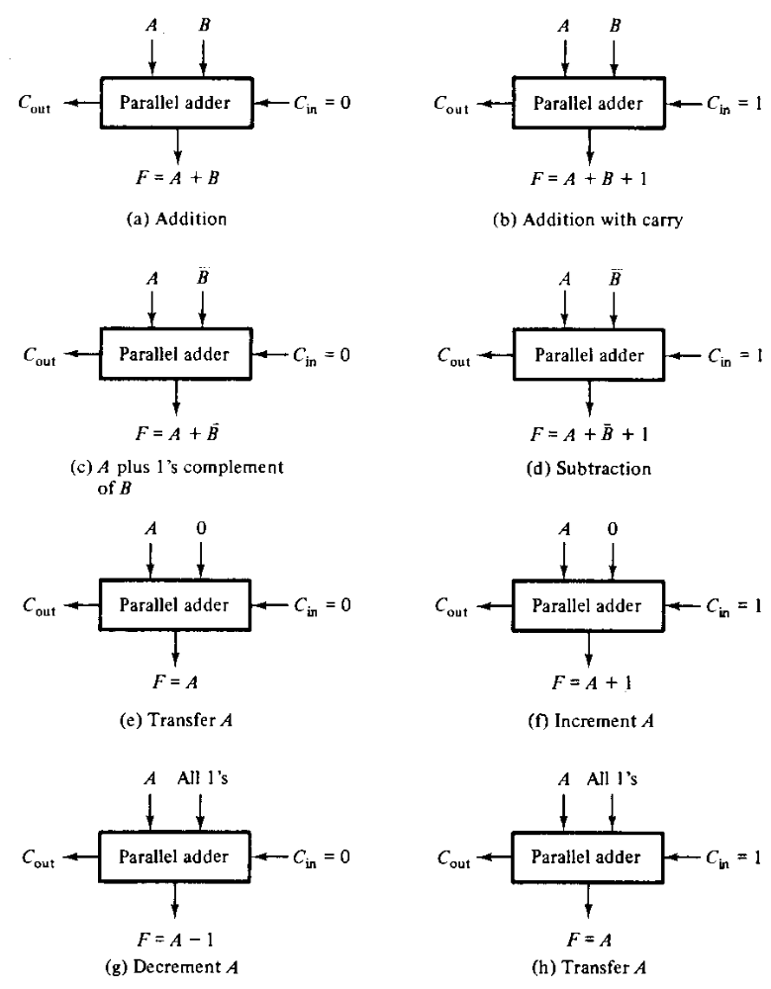
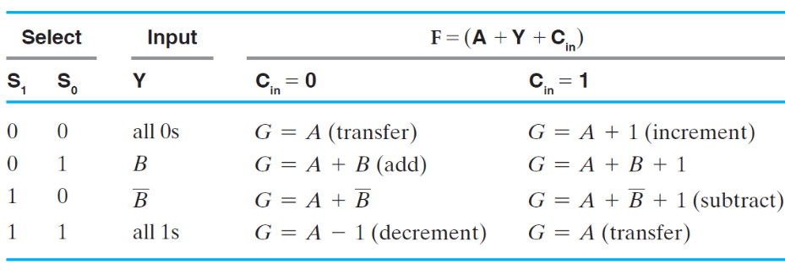
Arithmetic Logic Unit
Parallel-adder
  - Operations performed by changing only one variable of PA

Slide 14
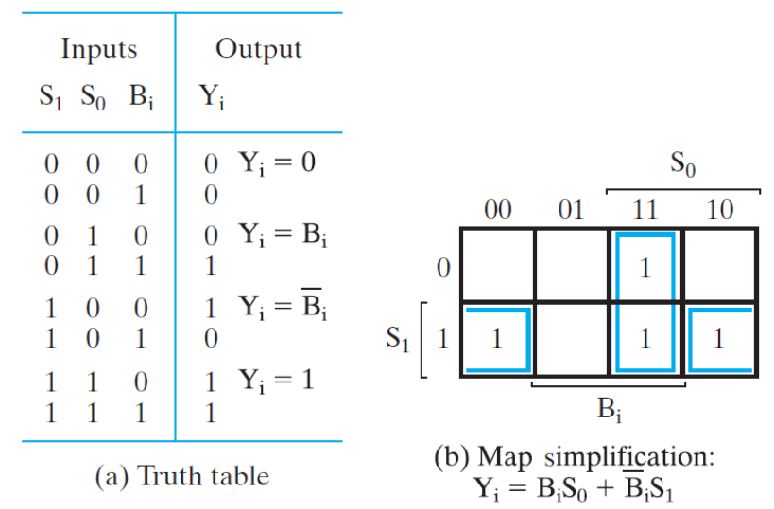
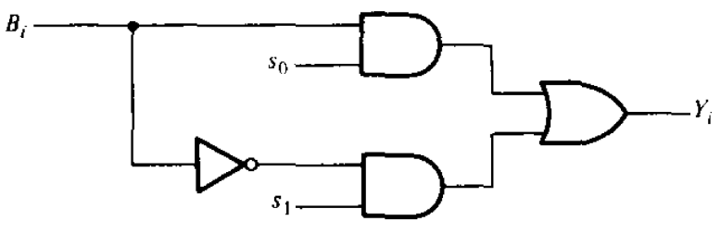
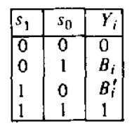
Arithmetic Logic Unit
Design of Arithmetic Unit
  To combine all this operations we need 2 selection variable along with carry.
    Note that the operations can be performed only by changing the B input and the carry.
    The selection circuit

Slide 15
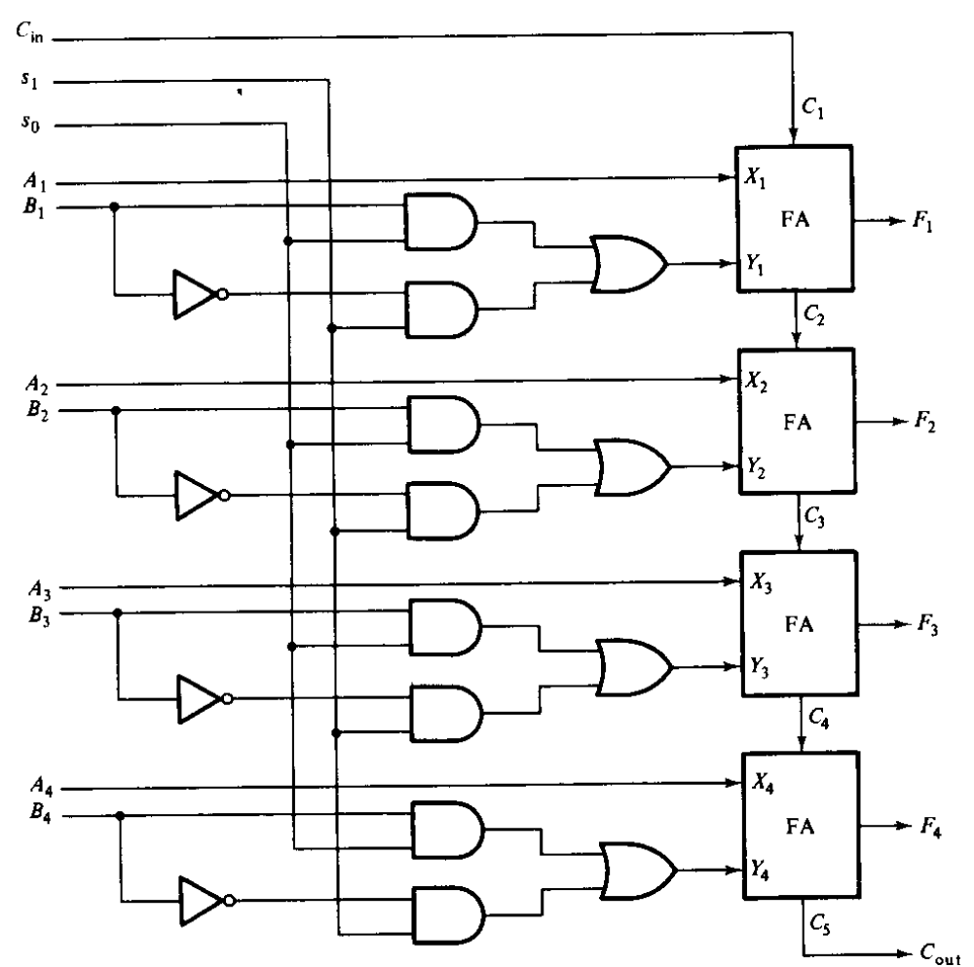
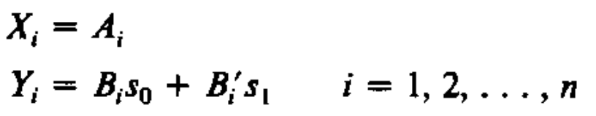
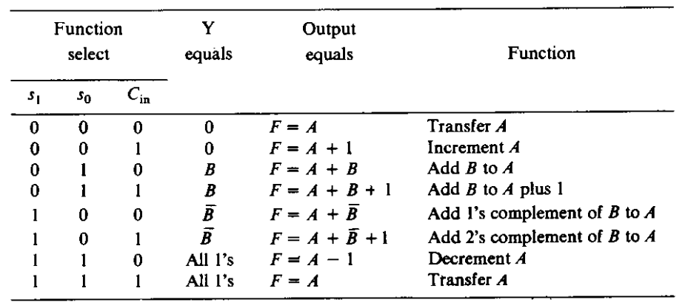
Arithmetic Logic Unit
Design of Arithmetic Unit
  The logic diagram

Slide 16
Arithmetic Logic Unit
Design other arithmetic circuit
  Example: Design an arithmetic circuit with
    When s=0 perform A+B
    When s=1 perform A-B
  Solution
    A+B requires
      C_{in}=0, X_{i}=A_{i} and Y_{i}=B_{i}
    A-B requires
      C_{in}=1, X_{i}=A_{i} and Y_{i}=B_{i}’

Slide 17
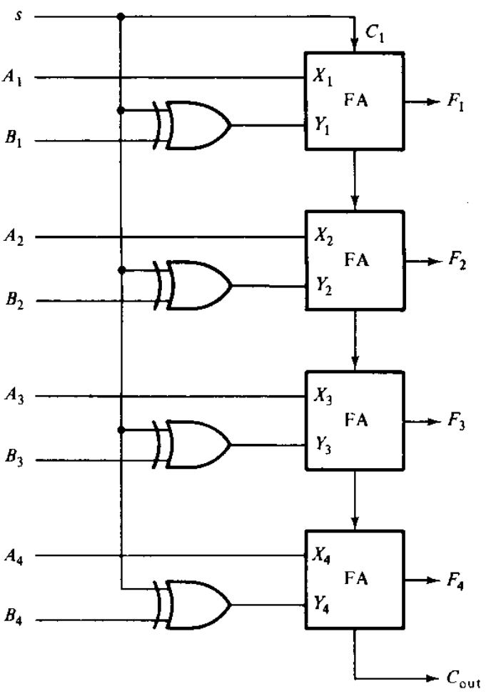
Arithmetic Logic Unit
Design other arithmetic circuit
S=0 : Perform A+B
S=1 : Perform A-B

Slide 18
Lesson-13:
Topic | Lesson Learning Outcomes | Teaching-Learning Methodology | Assessment Method
Logical Unit and ALU | To design of logical unit To design ALU by combining arithmetic and logic unit. | Class Lecture PBL (Solving some problems in class) | Test, exams, quiz, etc

Slide 19
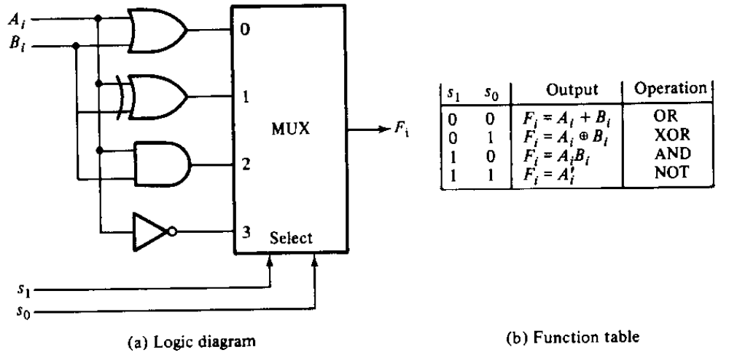
Arithmetic Logic Unit
Design of Logic Unit

Slide 20
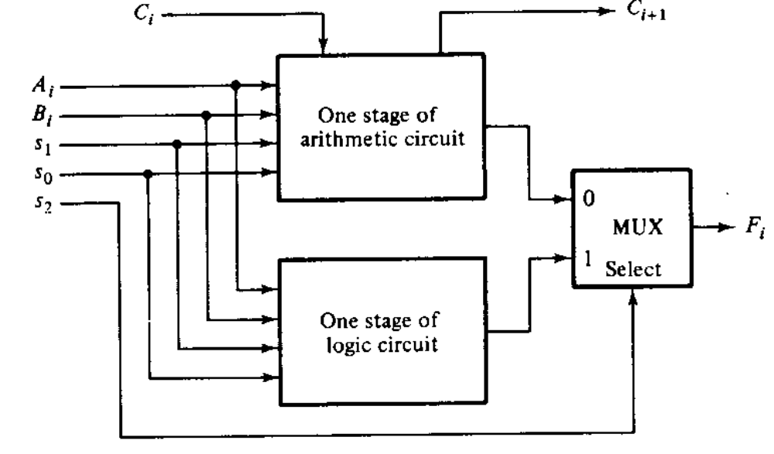
Arithmetic Logic Unit
Combining Arithmetic and Logic Unit

Slide 21
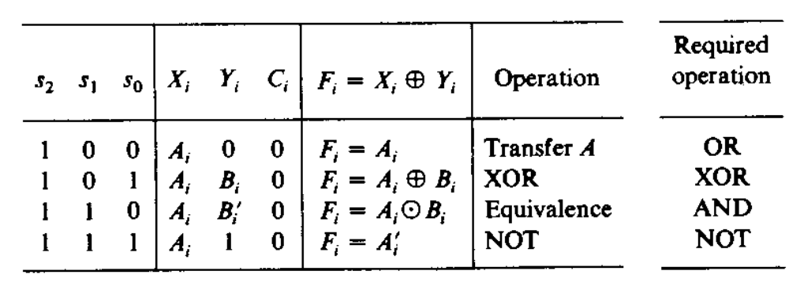
Arithmetic Logic Unit
How to Design More Efficient ALU
  Note
    Full-adder with C_{in}=0 performs XOR
    Table lists the possible operations
  Therefore, more efficient ALU design may be possible

Slide 22

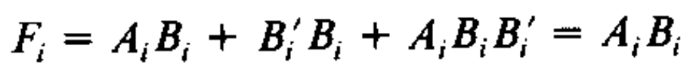
Arithmetic Logic Unit
More Efficient ALU
  With s₂s₁s₀=100
    Y_{i}=0, hence we need to change X_{i} from A_{i} to A_{i}+B_{i}
  With s₂s₁s₀=110
    Lets make a similarity with previous case
    Change X_{i} from A_{i} to A_{i}+K_{i}
    Consider

Slide 23
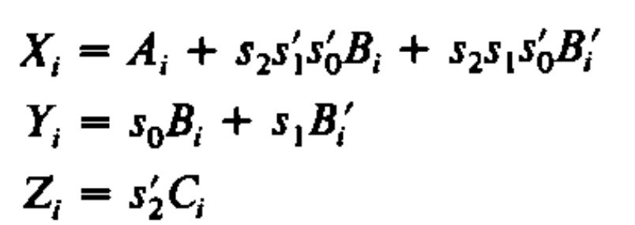
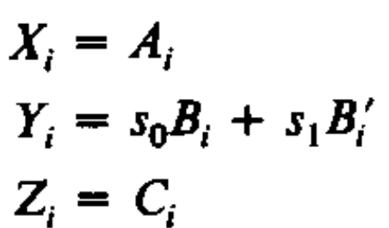
Arithmetic Logic Unit
More Efficient ALU
  Finally the inputs of the full adders are
  If s₂=0

Slide 24
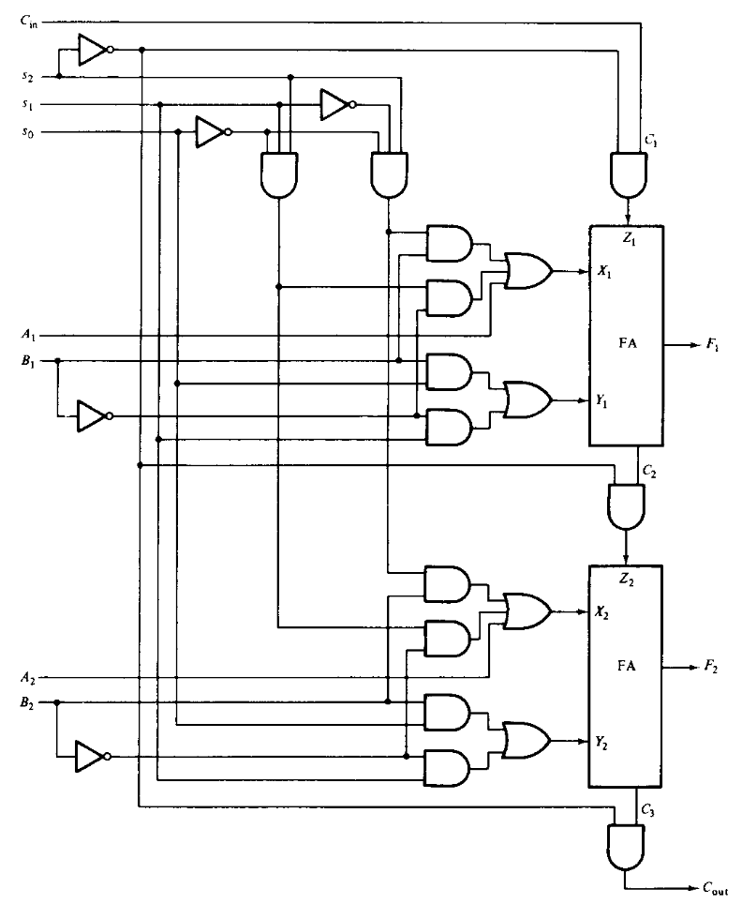
Arithmetic Logic Unit
More Efficient ALU

Slide 25
Lesson-14:
Topic | Lesson Learning Outcomes | Teaching-Learning Methodology | Assessment Method
Status register and shifter in ALU | To understand the design principle of Complete ALU and its components To know the importance and use of status register in ALU. To design shift register by using combinational circuit. | Class Lecture PBL (Solving some problems in class) | Test, exams, quiz, etc

Slide 26
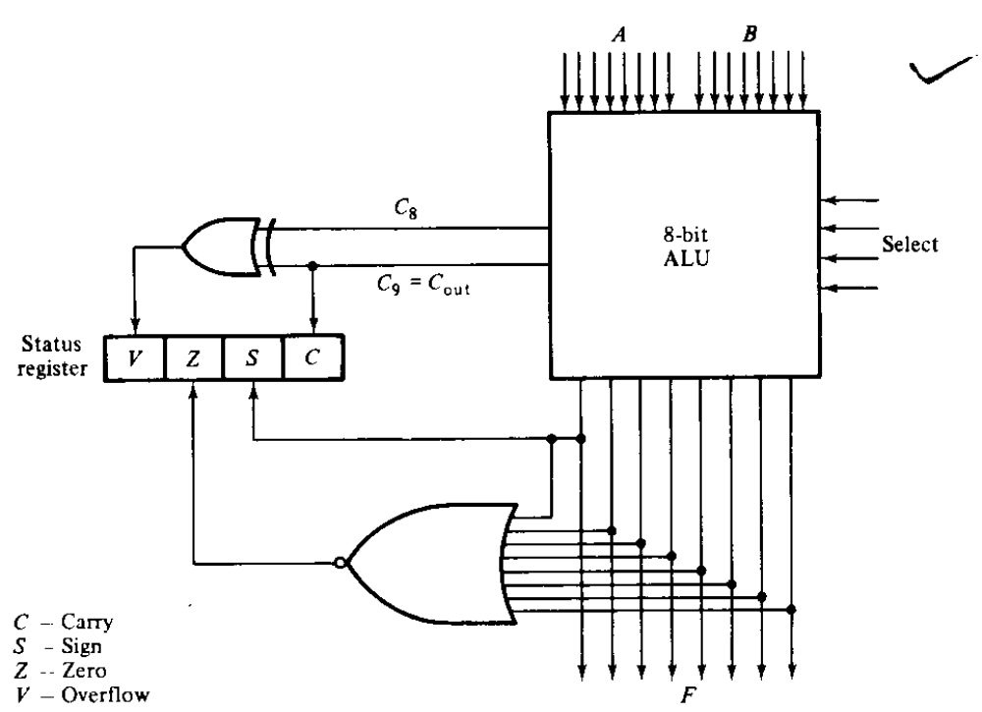
Arithmetic Logic Unit
Status Register

Slide 27
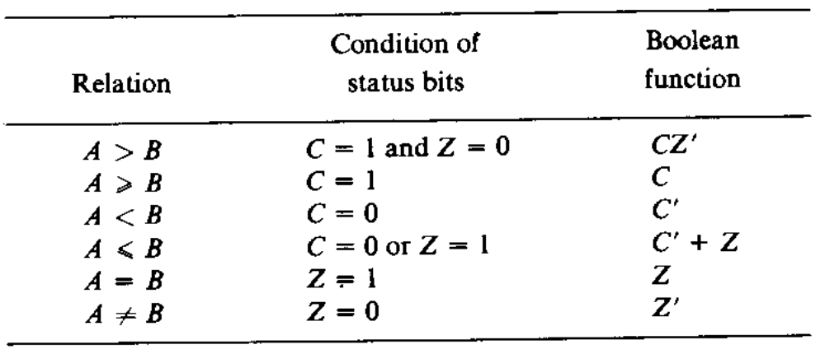
Arithmetic Logic Unit
Status bits after subtraction of two unsigned numbers (A-B)

Slide 28
Design of Shifter
The Shift Unit
  Connected after ALU.
    Bidirectional Shift register with parallel load can be used.
      But it requires 3 clock-pulses
    A combination circuit that can perform shift operation is a good choice
      Requires only one clock-puls.

Slide 29
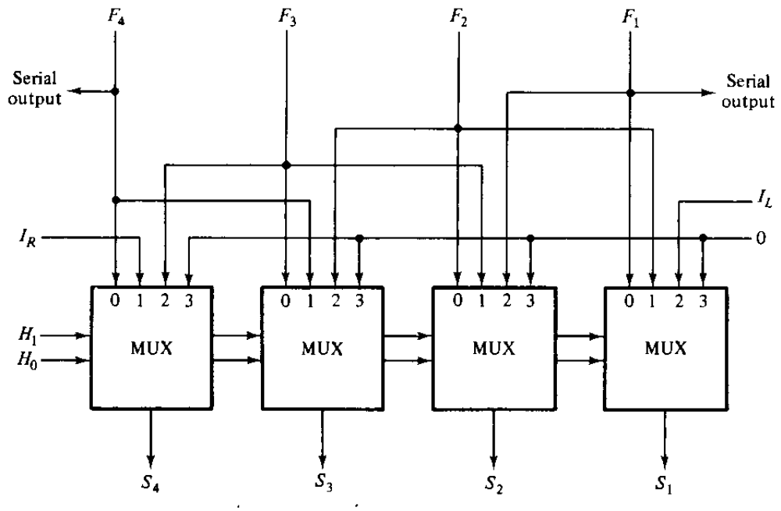
Design of Shifter
Combinational Shift Unit

Slide 30
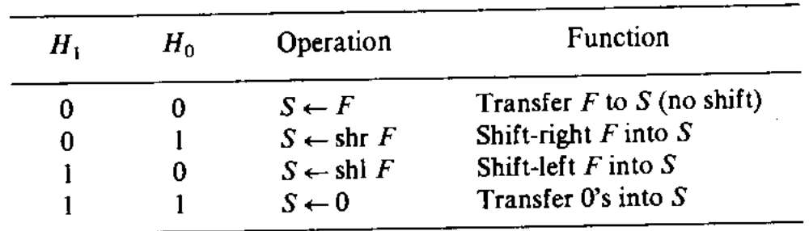
Design of Shifter
Function table of the shifter

Slide 31
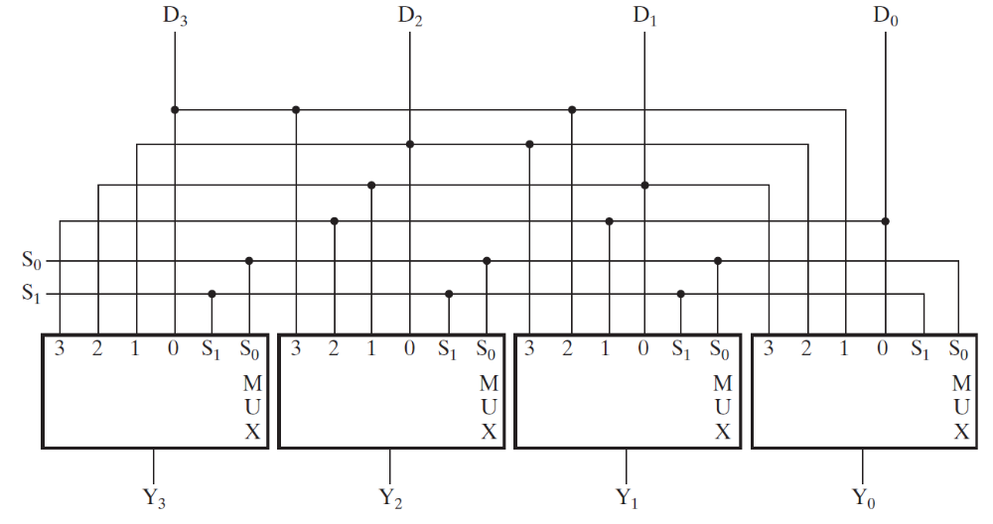
Design of Shifter
Barrel shifter
Often the data must be shifted more than one bit position in a single clock cycle.
A barrel shifter iss designed to do this as shown in Fig.

Slide 32
Lesson-15:
Topic | Lesson Learning Outcomes | Teaching-Learning Methodology | Assessment Method
Processor Unit | To construct a processor unit by using the designed ALU To understand the control word of processor and how they can use to perform various microoperations | Class Lecture Question and answer | Test, exams, quiz, etc

Slide 33
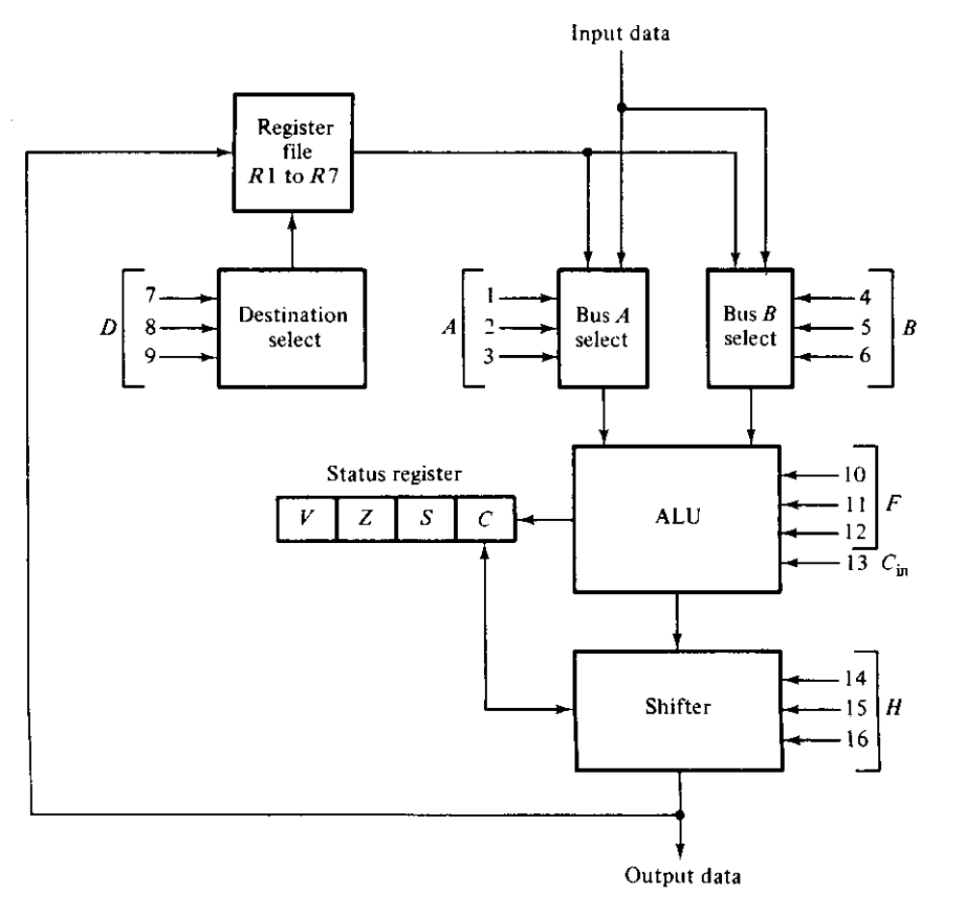
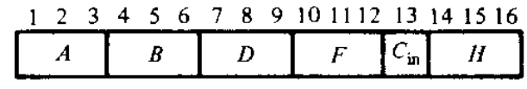
Processor Unit
Block Diagram

Slide 34
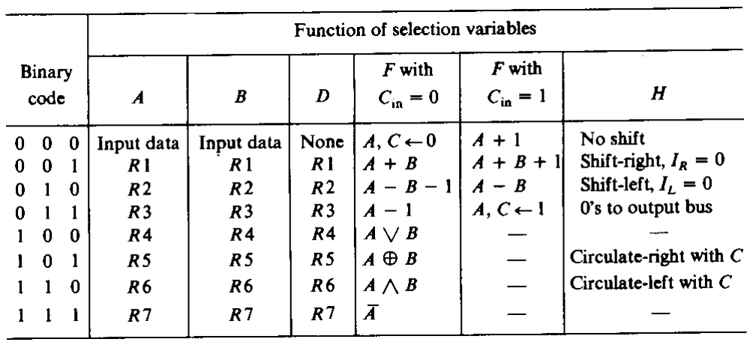
Processor Unit
Block Diagram with functions

Slide 35
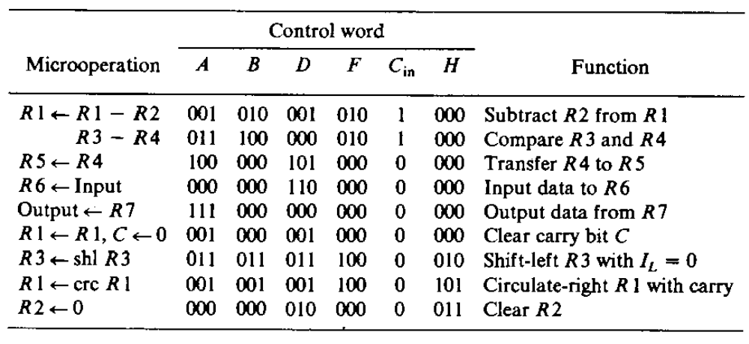
Processor Unit
Examples of Micro-operations

Slide 36
Processor Unit
Other operations
  How to shift the contents of a specific register?
  How to clear a specific register?
    There are several ways to perform these operations
    We need to find the simplest one.

Slide 37
Lesson-16:
Topic | Lesson Learning Outcomes | Teaching-Learning Methodology | Assessment Method
Design of Accumulator | To identify the requirements of accumulator design To design an accumulator using JK flipflop. | Class Lecture Question and answer | Test, exams, quiz, etc

Slide 38
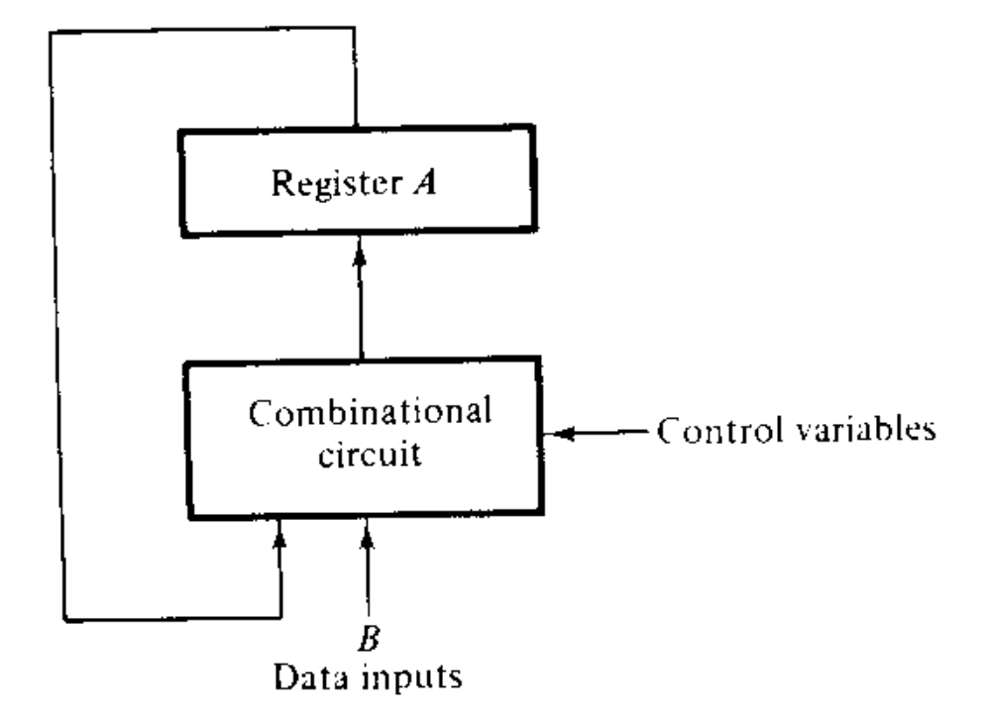
Design of Accumulator
Accumulator
  Not only the ‘register A’ but the combinational circuit is also a part of the accumulator.

Slide 39
Design of Accumulator
Accumulator
  A multi-functional register
    Not only perform the operations of commonly used register.
    It should be perform all the micro-operations in a processor unit.
    Also termed as multipurpose operational register.
    The design of accumulator is dependent on the number of micro-operations it should be performed.

Slide 40
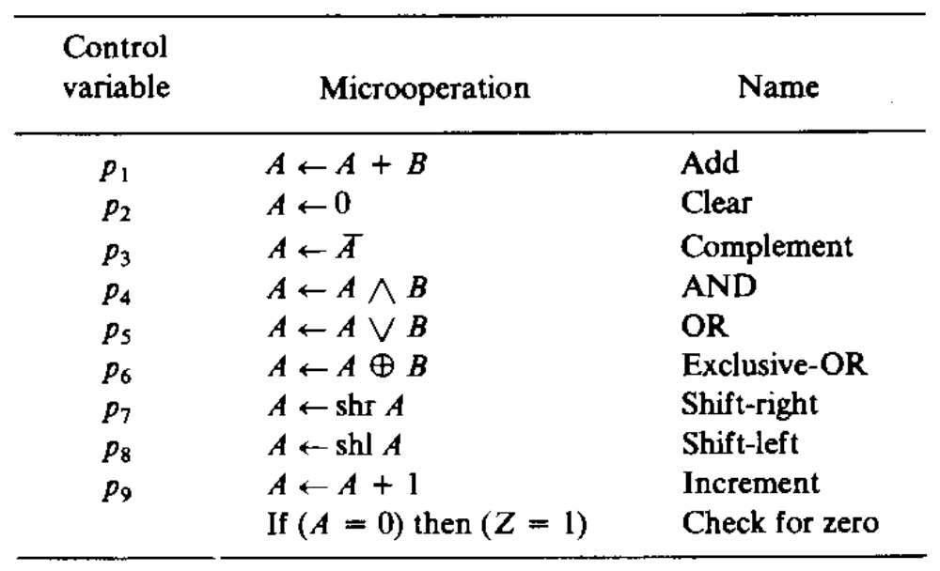
Design of Accumulator
List of micro operations for an accumulator

Slide 41
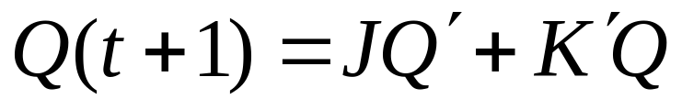
Design of Accumulator
Design procedure
  Each stage of the accumulator should be designed separately
    Stages A_{i} should connected in sequence i=1,…,n.
    Each stage should be deigned with a flip-flop
      In this example we will use JK flip-flop,
      Characteristics of JK flip-flop
    Control variables should be mutually exclusive.

Slide 42
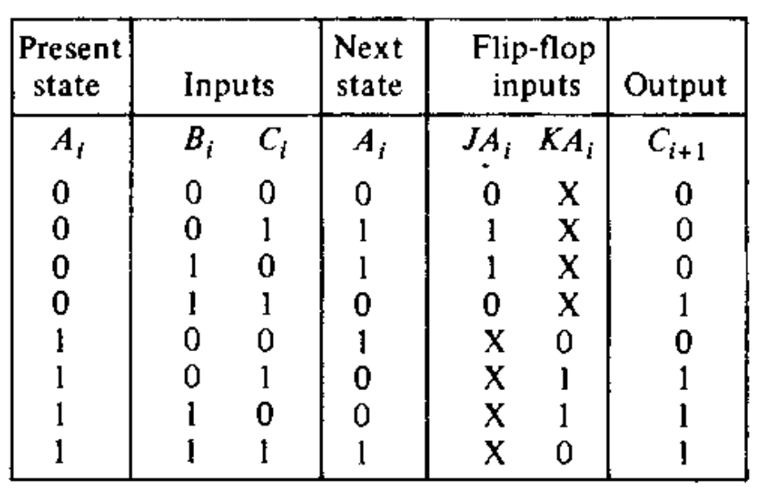
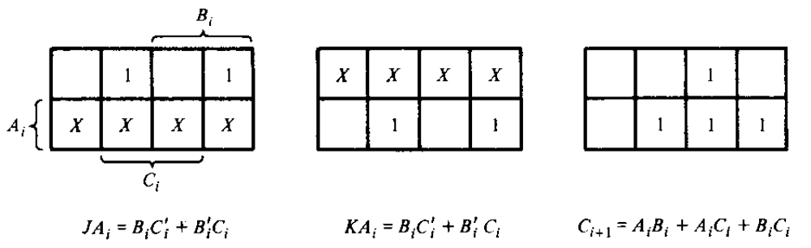
Design of Accumulator
Design procedure
  Add B to A
    Control variable p₁

Slide 43
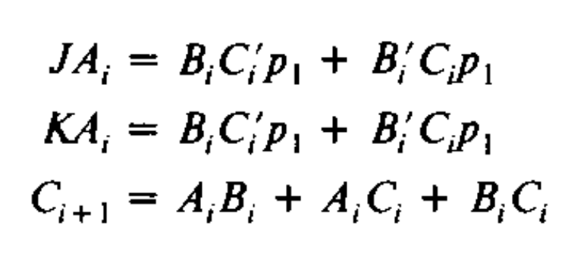
Design of Accumulator
Design procedure
  Add B to A (control variable p₁)
    The Boolean function with control variable

Slide 44
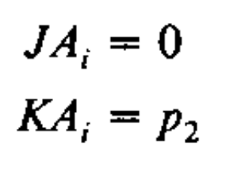
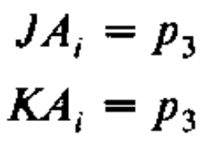
Design of Accumulator
Design procedure
  Clear A (p₂)
    We need only apply control variable to K.
    The Boolean function
  Complement (p₃)
    The Boolean function

Slide 45
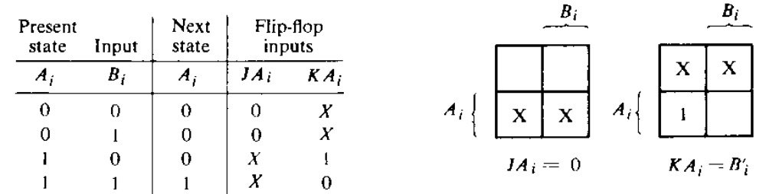
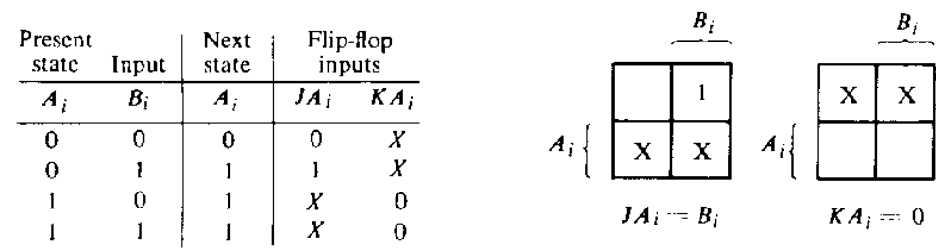
Design of Accumulator
Design procedure
  AND (p₄)
  OR (p₅)

Slide 46
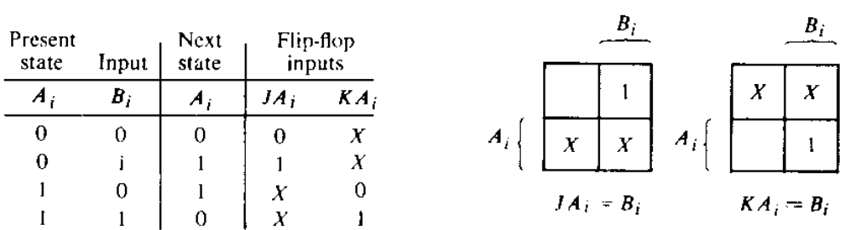
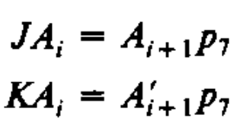
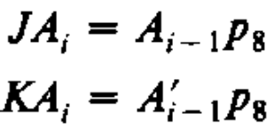
Design of Accumulator
Design procedure
  XOR (p₆)
  Shift right (p₇)
  Shift left (p₈)

Slide 47
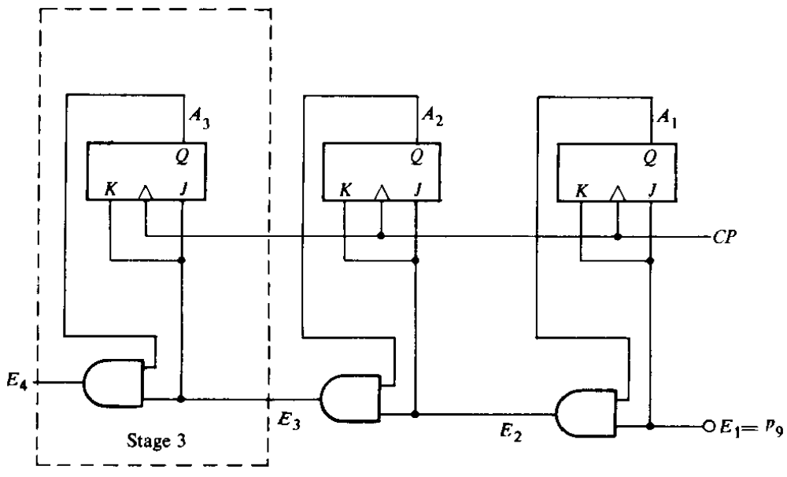
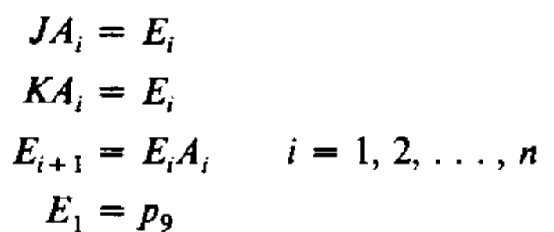
Design of Accumulator
Design procedure
  Increment (p₉)
    Similar with synchronous counter of fig. 7-17

Slide 48
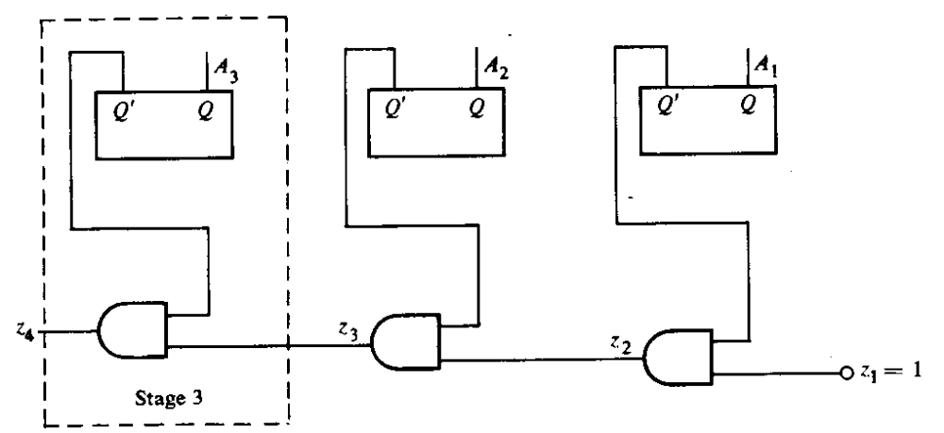
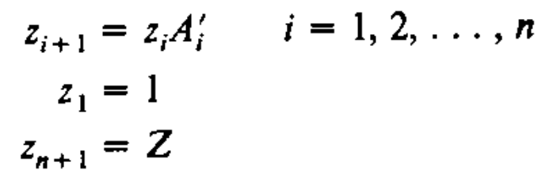
Design of Accumulator
Design procedure
  Check for zero (Z)

Slide 49
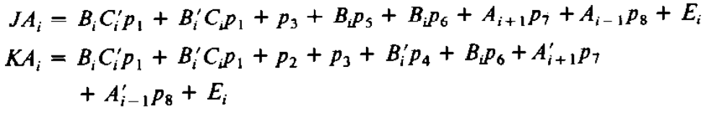

Design of Accumulator
Design procedure
  One stage of accumulator

Slide 50

Design of Accumulator
Design procedure
  One stage of accumulator

Slide 51

Design of Accumulator
Design procedure
  Complete accumulator
  4-bit accumulator with 4 stages

Slide 52
Lesson-17:
Topic | Lesson Learning Outcomes | Teaching-Learning Methodology | Assessment Method
Solving problems of Chapter-9 | To improve the problem solving skills | Class Lecture Homework | Test, exams, quiz, assignment, etc

